Slide 1
Uncontrolled copy not subject to amendment
Principles of Flight
Learning Outcome 2
Understand how the stability and manoeuvrability of an aeroplane are controlled
Part 3: Explain factors which cause an aeroplane to stall
Revision 2.00

Slide 2
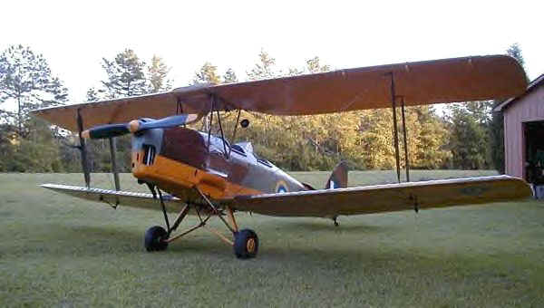
Principles of Flight
Revision

Slide 3
Questions for you …..

Slide 4
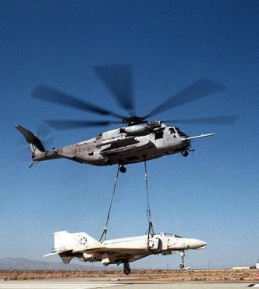
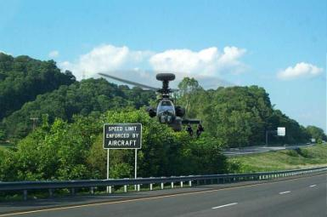
What effect does a trailing edge flap have on the stalling speed?
Higher
Lower
c. The same
d. No difference

Slide 5
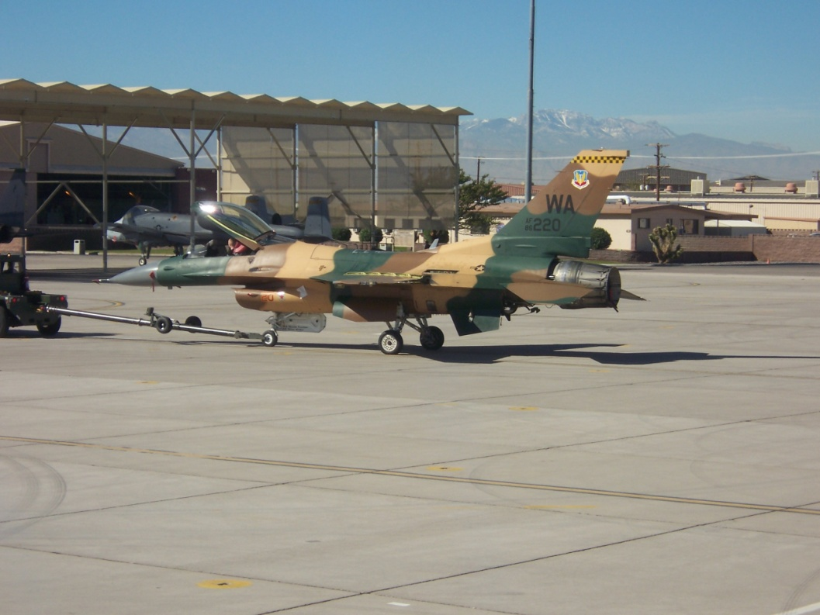
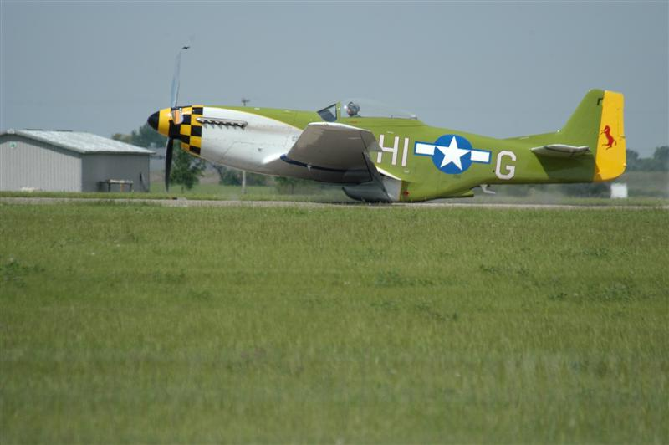
One type of leading edge flap is …..
Plain
Slot
c. Split
d. Krueger

Slide 6
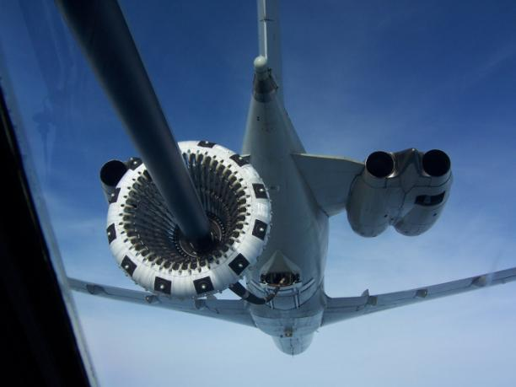
What are some of the high lift devices on the leading edge called?
a. Plain flaps
b. Ailerons
c. Slats
d. Split flaps

Slide 7
Stalling
Objectives:
Describe the stall in terms of lift
State the generally used critical or stall
angle of attack
Understand the relationship between stalling and
airspeed
State where the pilot obtains information regarding the
aircraft’s stalling speed
5. List the factors which affect the stalling speed

Slide 8
It is essential that a pilot understands stalling
During take-off and landing, the aircraft is at
low speed
In aerobatics the aircraft experiences high “G”
What has stalling got to do
with these?
Notes:
It is vital for a pilot to understand stalling thoroughly, if he is to fly an aircraft confidently at the low speeds required for take-off and landing, or in aerobatics and combat, where high “g” manoeuvres can cause a high-speed stall.

Slide 9
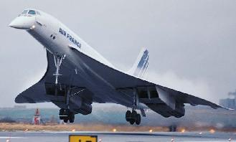
Stalling speed
Stalling speed is when:
The speed at which a clean aircraft (flaps up)
2. At a stated weight
3. With the throttle closed
4. Flying straight and level
5. Can no longer maintain height
Notes:
The airspeed at which an aircraft stalls (the stalling speed) does vary. For every type of aircraft there is a booklet called “Pilot’s Notes” which gives facts and figures about performance, including the aircraft’s various stalling speeds for certain flight conditions.

Slide 10
The mechanism of stalling

Slide 11
Boundary layer separation – low AoA
Towards lower
pressure - faster
Towards higher pressure
plus viscous adhesion -
slower
Transition point (perhaps)
from laminar to turbulent
boundary layer

Slide 12
Towards higher pressure
Plus viscous adhesion -
much slower
Towards lower
pressure - faster
Separation point

Slide 13
Towards lower
pressure - faster
Separation
complete

Slide 14
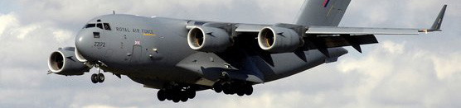
Factors affecting stalling speed
Aircraft weight
Notes:
The various factors which affect the stalling speed are:
Weight. Extra weight (for example, carrying more cargo) increases the stalling speed, and a lower weight (e.g. minimum fuel) reduces it.
b. Power. The higher the power used, the lower the stalling speed. This is because the engine’s thrust, although mostly horizontal, has a slight vertical component which helps the total lift force.
c. Flaps. With flaps lowered (which in effect improves the wing shape for low-speed flight) the stalling speed is reduced.
d. Ice. An accumulation of ice adversely alters the designed shape of the wing section, thereby reducing the lift and increasing the stalling speed.
e. Damaged Wings. Damage to a wing can similarly reduce the lift and so increase the stalling speed.
f. Manoeuvres. Most manoeuvres affect the stalling speed. In a turn the wings are banked, so the lift force is no longer vertical; this means that only a part of it is available to support the weight of the aircraft, so the stalling speed is increased: the steeper the turn, the higher the stalling speed.

Slide 15
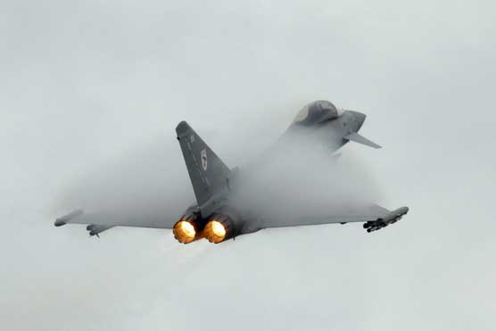
Pulling ‘G’

Slide 16
Danger
Danger
If you pull ‘g’, the stalling speed increases,
e.g. if you pull 4g the stalling speed doubles!
Danger
Danger

Slide 17
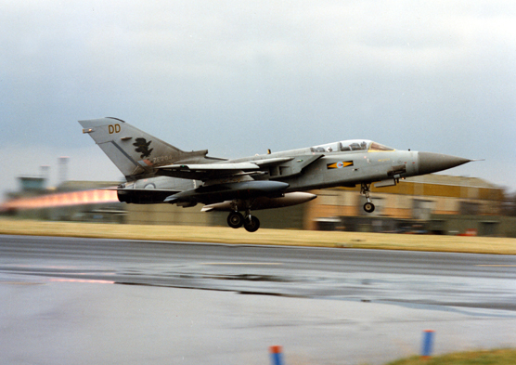
3. Engine thrust

Slide 18
The effect of thrust on stalling
Lift
Thrust
Flight path
Weight
Notes:
The greater the thrust, the lower the stalling speed. This is because the engine’s thrust, although mostly horizontal, has a slight vertical component which helps the total lift force.

Slide 19
Lift
Lift
TR
Thrust
Flight path
Weight

Slide 20
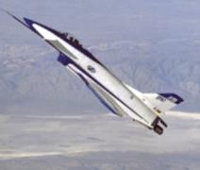
Flight path
Aircraft in level flight have a high nose attitude at the
stall, particularly swept wing aircraft
If the engine is at high power there are two thrust components:
a. Along the flight path (countering drag)
b. Vertical (opposing weight)
Therefore less lift is required from the wings, so:
SLOWER STALLING SPEED (V) AT C_{LMAX}

Slide 21
Natural stall warning
Speed
Nose attitude
Controls
Light buffet
Heavy buffet
Nose drop
Wing drop
Descent

Slide 22
Turbulent air
missing
tailplane
Normal flight

Slide 23
Turbulent air
missing
tailplane
Turbulent air
Just touching
tailplane
Stall warning
Light buffet
Normal flight

Slide 24
Turbulent air
just touching
tailplane
Turbulent air
covering
tailplane
Stall warning
Light buffet
Stall
Heavy buffet
Aircraft descending

Slide 25
Typical stall warning vane
Vane held down by airflow
Micro-switch not made
No stall warning given
Vane lifted up by airflow
Micro-switch made
Stall warning given

Slide 26
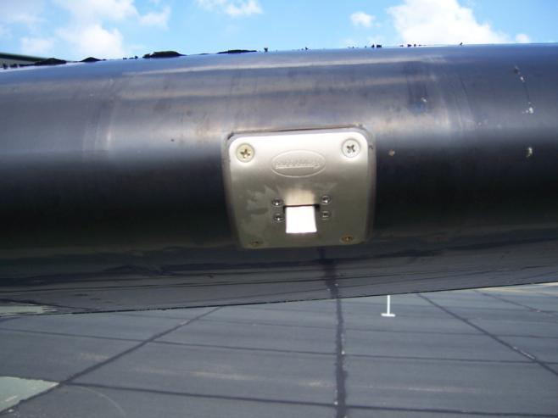
Example of a stall warning vane

Slide 27
The effect of the flap
Basic ‘clean’ situation
Chord
α
Relative airflow
Notes:
LIFT AUGMENTATION DEVICES
How does each inc cCl , camber etc?

Slide 28
Flap lowered
Basic ‘clean’ situation
Chord
α
Relative airflow
Effective increase in AoA
Notes:
LIFT AUGMENTATION DEVICES
How does each inc cCl , camber etc?

Slide 29
Flap Lowered
Maintaining the same lift
α
To obtain the same C_{L} the attitude is lowered to reduce the AoA
Effective Increase in AoA
Notes:
LIFT AUGMENTATION DEVICES
How does each inc cCl , camber etc?

Slide 30
Stall recovery

Slide 31
Standard stall recovery
Move stick centrally forward until buffet stops
2. Open throttle at the same time
3. Only then level the wings
4. Raise nose at a safe speed and climb

Slide 32
Other factors affecting stalling
1. Ice:
Alters the shape of the wing, this will reduce lift
2. Damage:
Can also reduce lift, for example after a bird strike

Slide 33
Summary of stalling speeds
What happens to the stalling speed .....
1. If aircraft weight increases?
The stalling speed will increase
2. If we lower the flap?
The stalling speed will decrease
3. If we are pulling “G”?
The stalling speed will increase
4. If the aircraft is damaged or has had a birdstrike?
The stalling speed will probably increase
5. If using engine thrust?
The stalling speed will decrease

Slide 34
Remember:
An aircraft can stall in any attitude –
level, turning, upside-down etc.
2. Where would we find our stalling speeds?
Pilot’s Notes or Aircrew Manual
Notes:
Pilot’s Notes
A typical entry in Pilot’s Notes may read:
The approximate stalling speed for a Bulldog aircraft flying at its maximum permitted weight (2350 lbs) would be:
a. Power off, flaps up, 53 knots
b. Power off, flaps fully down, 50 knots
c. Power on, typical approach conditions, 45 knots
The pilot knows that these airspeeds apply only when the aircraft is not in a turn or indeed in any manoeuvre which imposes a “g” force on the aircraft.
Various wings-level manoeuvres will also affect the stalling speed; for example, in a loop the stalling speed at the top (when the aircraft is upside-down) can be below the basic figure, as the effective weight of the aircraft is temporarily below normal. Conversely, in the last quarter of the loop, when the manoeuvre involves changing from vertically downwards to straight and level (the same as “pulling out of” a dive), the effective weight of the aircraft is temporarily increased, hence so is the stalling speed.
Various wings-level manoeuvres will also affect the stalling speed; for example, in a loop the stalling speed at the top (when the aircraft is upside-down) can be below the basic figure, as the effective weight of the aircraft is temporarily below normal. Conversely, in the last quarter of the loop, when the manoeuvre involves changing from vertically downwards to straight and level (the same as pulling out of a dive), the effective weight of the aircraft is temporarily increased, hence so is the stalling speed.

Slide 35
Any questions?

Slide 36
Questions for you …..

Slide 37
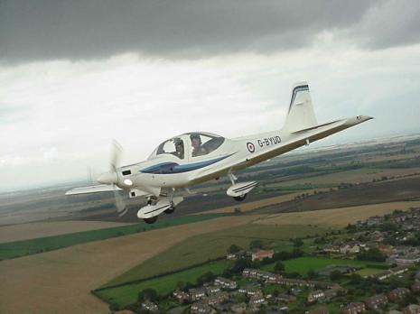
What happens to lift when a wing is stalled?
Lift increases as the angle of attack decreases
Lift decreases as the angle of attack increases
Lift is greatly reduced
Lift remains unchanged

Slide 38
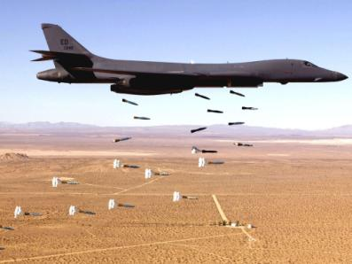
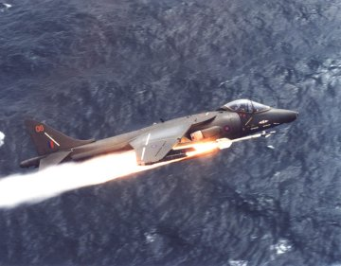
The critical angle of attack is generally about:
5º
15º
25º
35º

Slide 39
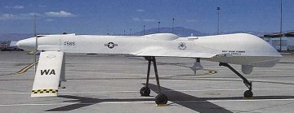
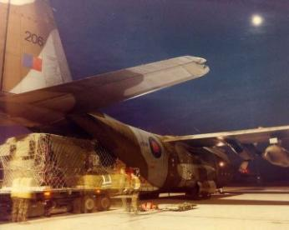
3. Which of the following will not reduce the stalling speed?
Extra weight
Larger wing area
Flaps lowered
Flaps raised

Slide 40
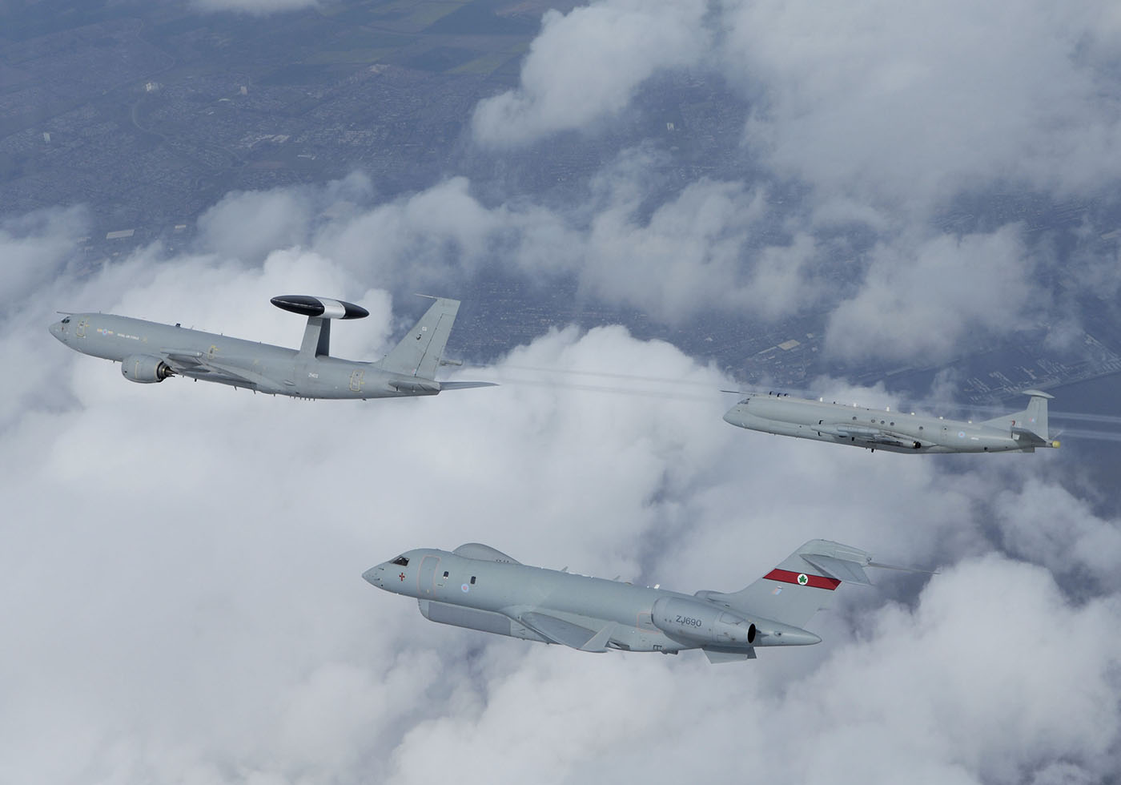
Where would you find the information regarding the aircraft’s various stalling speeds?
Pilot’s Notes
Air Traffic Control
Ground crew
McDonald’s

